Slide 1
Dynamic Memory Allocation

Slide 2
Allocation of Memory
Static Allocation: Allocation of memory space when execution begins.
Dynamic Allocation: Allocation of memory space at run time.

Slide 3
Dynamic memory Allocation
Dynamic memory allocation allows your program to obtain more memory space while running, or to release it if it's not required.
There are 4 library functions provided by C defined under <stdlib.h> header file to facilitate dynamic memory allocation in C programming.
Dynamically allocate memory in your C program using C standard library functions: malloc(), calloc(), free() and realloc()
Function | Use of Function
malloc() | Allocates requested size of bytes and returns a pointer first byte of allocated space
calloc() | Allocates space for an array elements, initializes to zero and then returns a pointer to memory
free() | deallocate the previously allocated space
realloc() | Change the size of previously allocated space

Slide 4
malloc() & free()
malloc()
The name malloc stands for "memory allocation".
The function malloc() reserves a block of memory of specified size and return a pointer of type void which can be casted into pointer of any form.
Syntax of malloc()
ptr = (cast-type*) malloc(byte-size)
Example
ptr = (int*) malloc(100 * sizeof(int));
free()
Dynamically allocated memory created with either calloc() or malloc() doesn't get freed on its own. You must explicitly use free() to release the space.
syntax of free()
free(ptr);

Slide 5
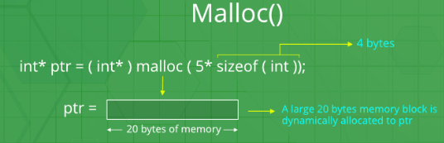

Slide 6
Sum of N elements using malloc()
#include <stdio.h>
#include <stdlib.h>
int main()
{
int num, i, *ptr, sum = 0;
printf("Enter number of elements: ");
scanf("%d", &num);
ptr = (int*) malloc(num * sizeof(int)); //memory allocated using malloc
if(ptr == NULL)
{
printf("Error! memory not allocated.");
exit(0);
}
printf("Enter elements of array: ");
for(i = 0; i < num; ++i)
{
scanf("%d", ptr + i);
sum += *(ptr + i);
}
printf("Sum = %d", sum);
free(ptr);
return 0;
}

Slide 7
calloc()
The name calloc stands for "contiguous allocation".
The only difference between malloc() and calloc() is that, malloc() allocates single block of memory whereas calloc() allocates multiple blocks of memory each of same size and sets all bytes to zero.
Syntax of calloc()
ptr = (cast-type*)calloc(n, element-size);
n is the no. of elements and element-size is the size of each element.
Example:
ptr = (float*) calloc(25, sizeof(float));

Slide 8
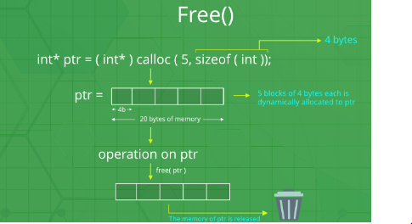

Slide 9
Sum of N elements using calloc()
#include <stdio.h>
#include <stdlib.h>
int main()
{
int num, i, *ptr, sum = 0;
printf("Enter number of elements: ");
scanf("%d", &num);
ptr = (int*) calloc(num, sizeof(int));
if(ptr == NULL)
{
printf("Error! memory not allocated.");
exit(0);
}
printf("Enter elements of array: ");
for(i = 0; i < num; ++i)
{
scanf("%d", ptr + i);
sum += *(ptr + i);
}
printf("Sum = %d", sum);
free(ptr);
return 0;
}

Slide 10
realloc()
If the previously allocated memory is insufficient or more than required, you can change the previously allocated memory size using realloc().
Syntax of realloc()
ptr = realloc(ptr, newsize);

Slide 11
Using realloc()
#include <stdio.h>
#include <stdlib.h>
int main()
{
int *ptr, i , n1, n2;
printf("Enter size of array: ");
scanf("%d", &n1);
ptr = (int*) malloc(n1 * sizeof(int));
printf("Address of previously allocated memory: ");
for(i = 0; i < n1; ++i)
printf("%u\t",ptr + i);
printf("\nEnter new size of array: ");
scanf("%d", &n2);
ptr = realloc(ptr, n2);
for(i = 0; i < n2; ++i)
printf("%u\t", ptr + i);
return 0;
}

Slide 12
Dynamic Memory Allocation for Structure
#include <stdio.h>
#include <stdlib.h>
struct person {
int age;
float weight;
char name[30];
};
int main()
{
struct person *ptr;
int i, num;
printf("Enter number of persons: ");
scanf("%d", &num);
ptr = (struct person*) malloc(num * sizeof(struct person));
for(i = 0; i < num; ++i)
{
printf("Enter name, age and weight of the person respectively:\n");
scanf("%s%d%f", &(ptr+i)->name, &(ptr+i)->age, &(ptr+i)->weight);
}
printf("Displaying Infromation:\n");
for(i = 0; i < num; ++i)
printf("%s\t%d\t%.2f\n", (ptr+i)->name, (ptr+i)->age, (ptr+i)->weight);
return 0;
}

